Slide 1


Slide 2
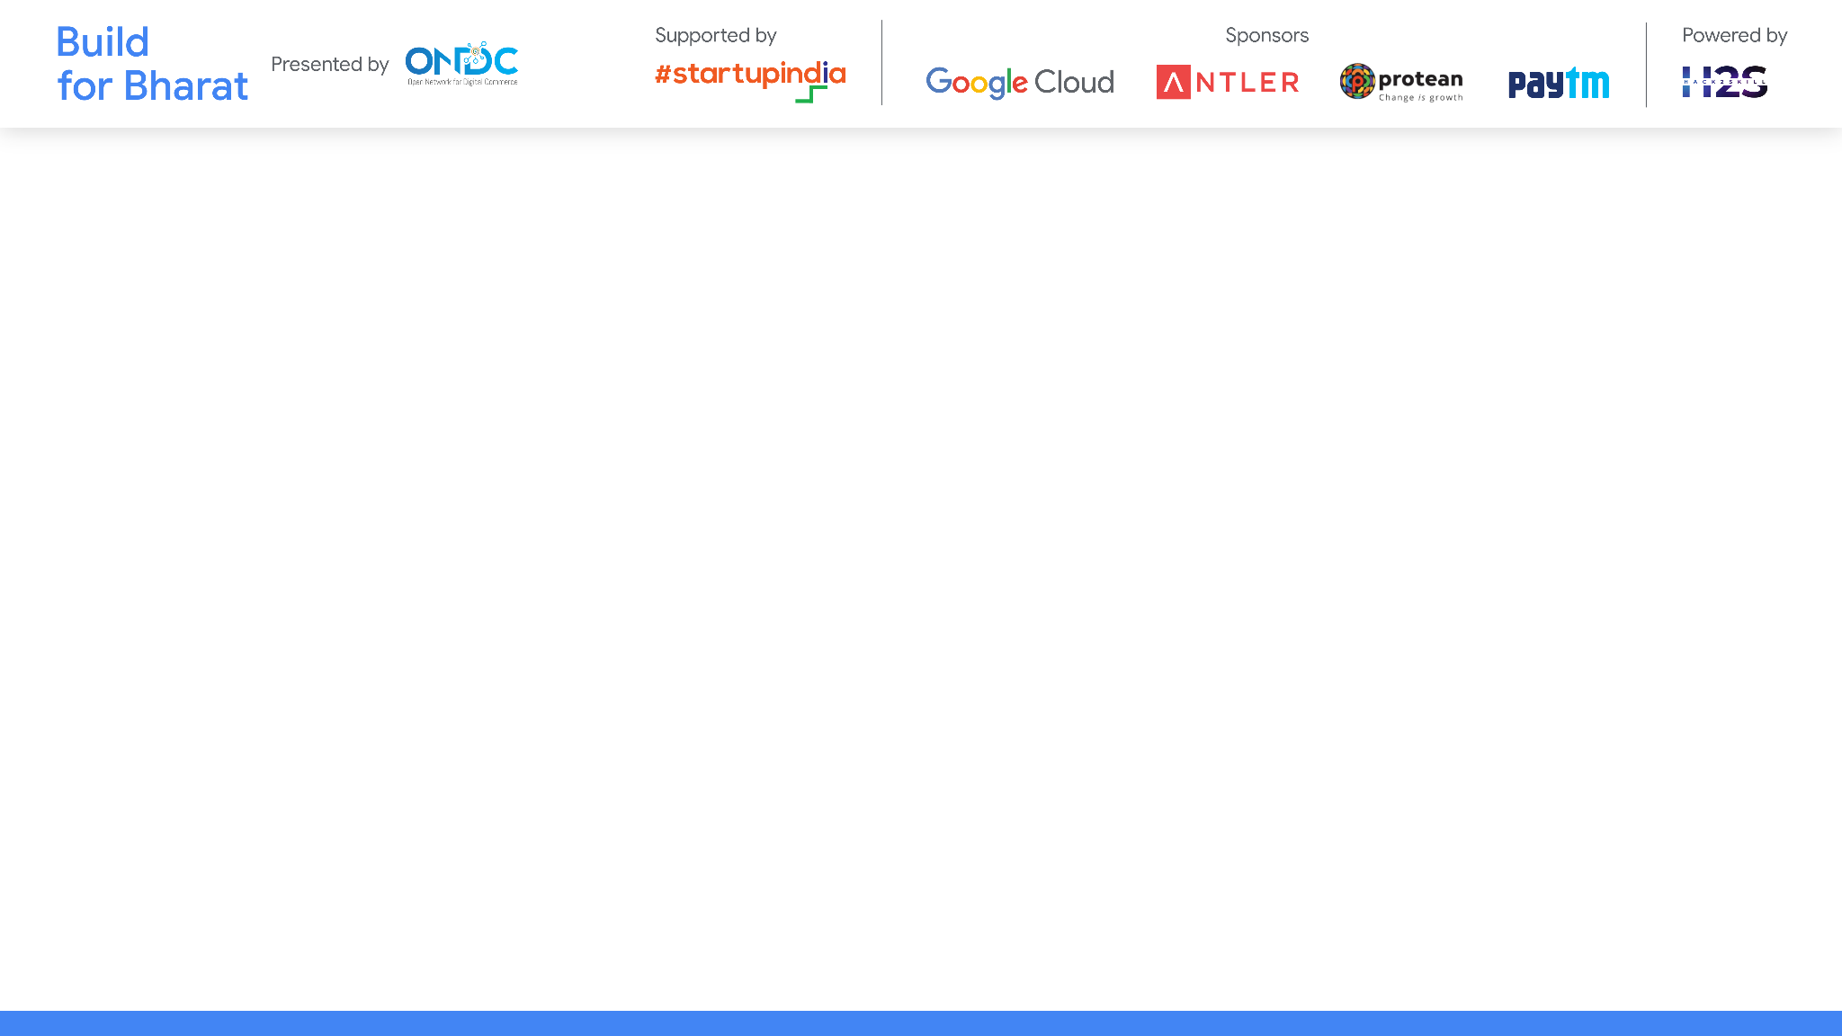
Team Name: Tri-engineers for Bharath
Team Leader Name: THUNGA VEMA REDDY
Team Member Names: TAMATAM BABUL REDDY
THOORPU AKHILESH REDDY
Problem Statement Category: Foundational
Problem Statement: RESPONSIVE FOOTWEAR FOR THE BLIND PEOPLE
*You can make a copy of the slides. Do not change the template branding.

Slide 3
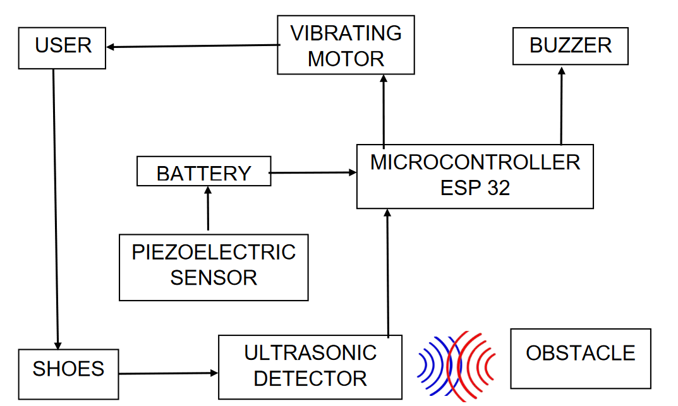
Architecture & Design for the innovative solution.

Slide 4
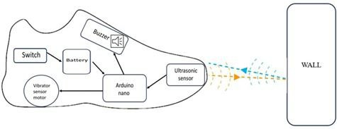
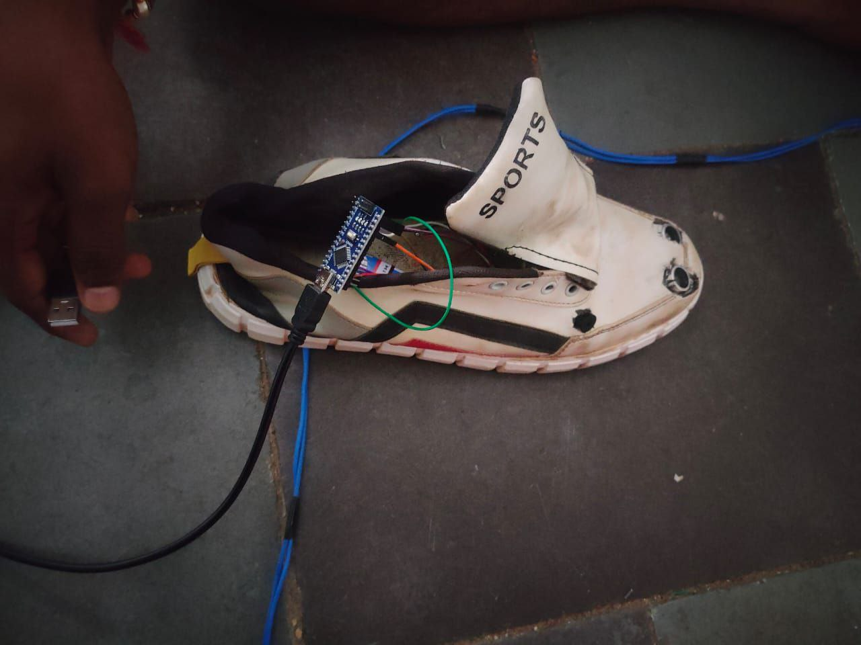
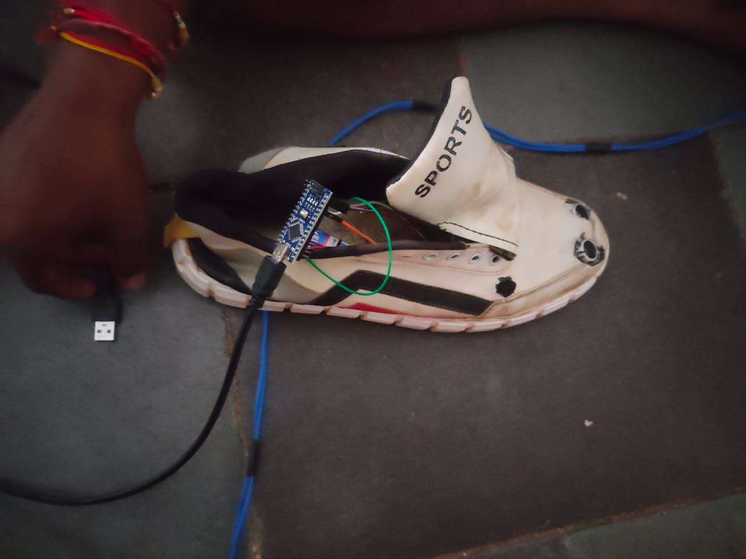
Define customization & deployment options of your proposed solution.

Slide 5
Test cases & data (as applicable) against which the eval criteria can be assessed
Navigating the world without sight can be challenging, especially when it comes to avoiding obstacles. While canes and guide dogs offer support, an exciting opportunity awaits us. We envision crafting "Smart Shoes" equipped with ingenious sensors and seamless communication. These remarkable shoes will not only alert users about obstacles but also provide guidance, empowering blind individuals to explore confidently. The main hurdle is to ensure these shoes impeccably detect obstacles and adeptly steer users, ushering in a new era of independent mobility.
*You can make a copy of the slides. Do not change the template branding.

Slide 6
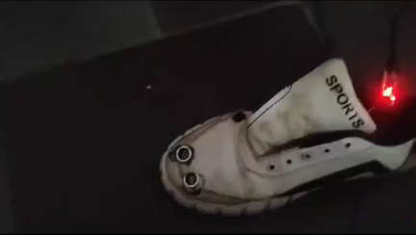
Demonstrate working of the solution to the evaluation team
CLICK ANYWHERE ON THE VEDIO TO SHOW PLAY BUTTON
PLAY IT
*You can make a copy of the slides. Do not change the template branding.

Slide 7
Important Links:-
GitHub Public Repository Link
Link to test cases and data files
*You can make a copy of the slides. Do not change the template branding.

Slide 8


